Slide 1
GP-GDL Sprint_1

Slide 2
Agenda:
1- Mind mapping.
2- CNN Tutorial.
3- Shaden Program Example.
4- Omar Program Example.
5- Zeinab Program Example.
6- Mohammed Program Example.

Slide 3
Mind Mapping
1- Platform Installation & Work stations.
2- Data Collection.
3- CNN & Platform different tutorials.
4- Code Implementation.

Slide 4
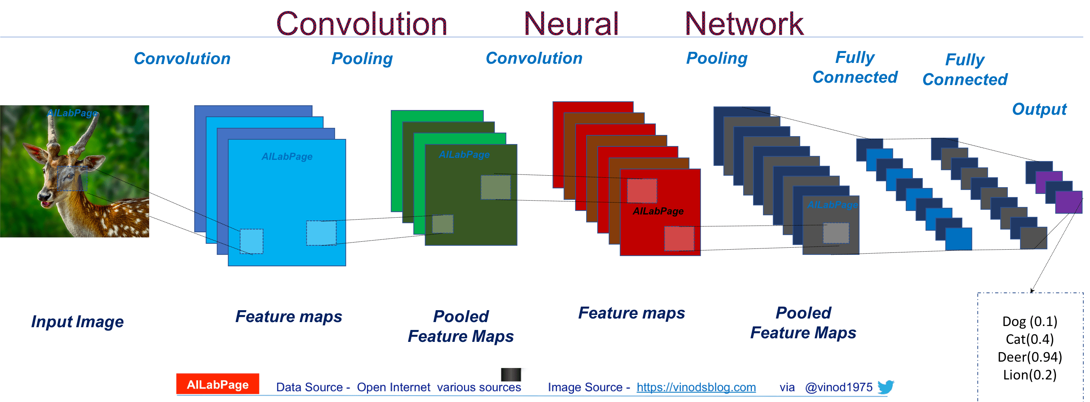
CNN Tutorial

Slide 5
Milestones:
Introduction.
What is CNN?
CNN Applications.
CNN Layers.
Common CNN architectures.

Slide 6
Introduction
Original Goal:
“How to create good representations of the visual world in a way it could be used to support recognition”
Key features:
Detect and classify objects into categories
Independence from pose, scale, illumination, conformation and clutter

Slide 7
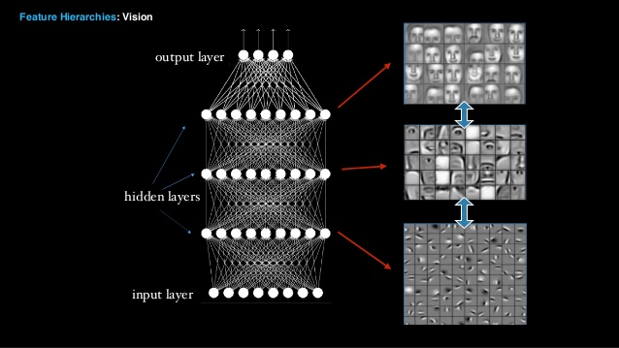
What is CNN?
CNN stands for Convolution Neural Network
CNN is a set of layers with each of them being responsible to detect a set of feature sets and these features are going to be more abstract as it goes further into examining the next layer
Before CNN, feature selection was a time consuming step which is now solved by CNN’s hidden layers
The chosen features could simply be: Color – Object edges – Pixel Location

Slide 8
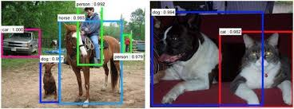
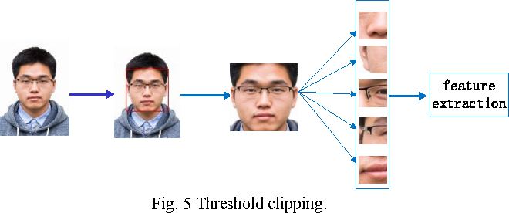
CNN Applications
Signal and Image Processing
Handwritten text/digits Recognition
Segmentation
Natural Object Classification (Photos/Videos)
Face Detection
Recommender System
Speech Recognition
Natural Language Processing

Slide 9

CNN Layers
CNN consists of multiple layers:
Convolution Layer
Pooling Layer
Fully Connected Layer

Slide 10
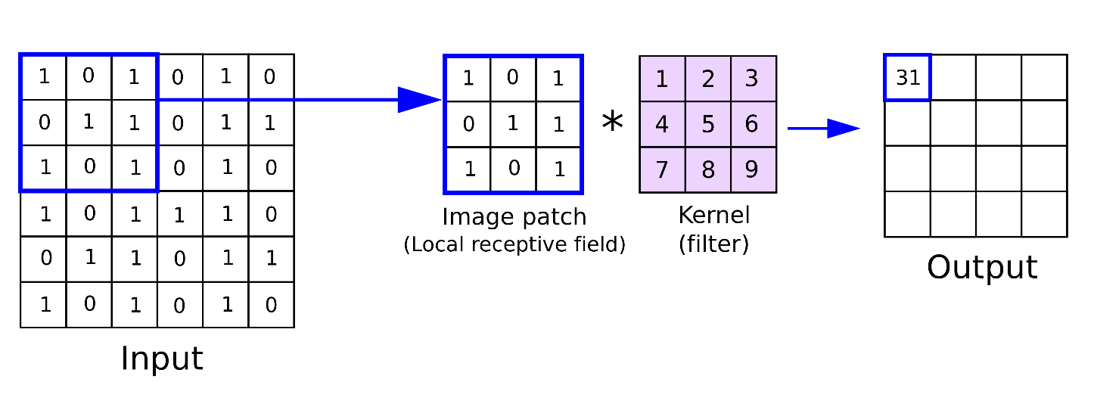
[1] Convolution Layer
The main purpose of it is to detect different patterns or features from an input image
It is a simple matrix multiplication process
To make a decision as to whether each hidden neuron should be fired or not so we have to add activation functions to the neurons

Slide 11
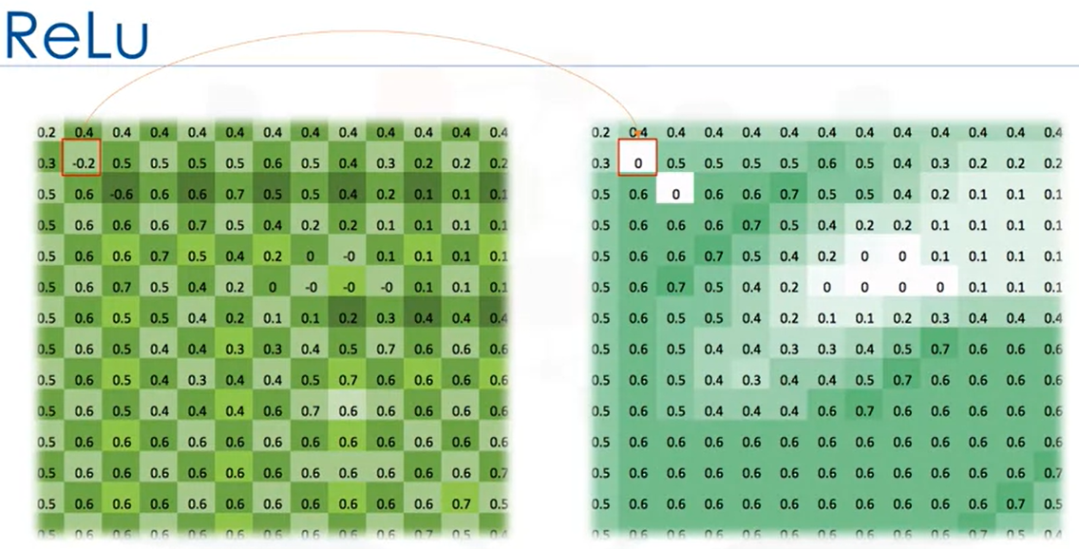
ReLu Activation Function
ReLu is a non linear activation function used to increase the non-linear properties of the decision function
ReLu stands for Rectified Linear unit
It simply takes the max(0,x) if x is negative value, it will be swapped by zero

Slide 12
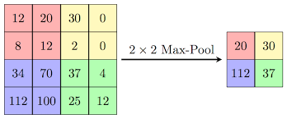
[2] Pooling layer
We have to downsample the output images from the ReLu function to reduce the dimensionality of the activated neurons so we use another layer called Max Pooling
It is an operation that finds the maximum values and simplifies the input
It turns the low-level data into higher level information

Slide 13
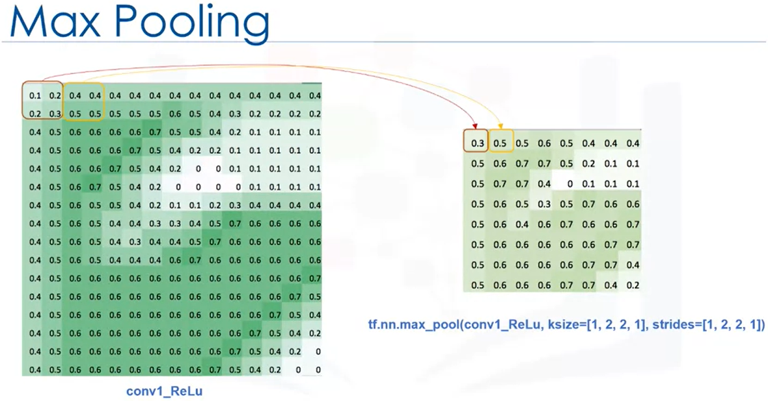
cont. Pooling Layer
For example we can select a window of size (2x2) and then select the maximum value for this matrix as in the figure
We can define Strides which determines the sliding behavior of the max pooling

Slide 14
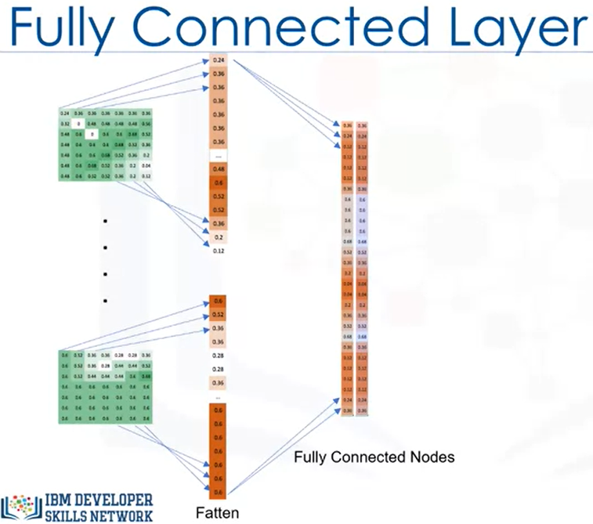
[3] Fully Connected layer
It takes the high-level filtered images from the previous layer and convert them into a 1D vector
Step one: Each matrix is 1D vector
Step two: All matrices will be fully connected together with the hidden layers between them

Slide 15
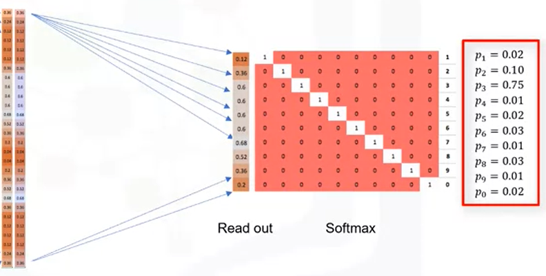
Softmax Activation Function
Finally we can use an activation function called “Softmax” that is normally used in classification problems
It generates the Probabilities of the output

Slide 16
Common CNN Architectures:
1- Classic network architectures:
LeNet-5.
AlexNet.
VGG16.
2- Modern network architectures:
Inception.
ResNet.
ResNeXt.
DenseNet.
https://www.jeremyjordan.me/convnet-architectures/

Slide 17
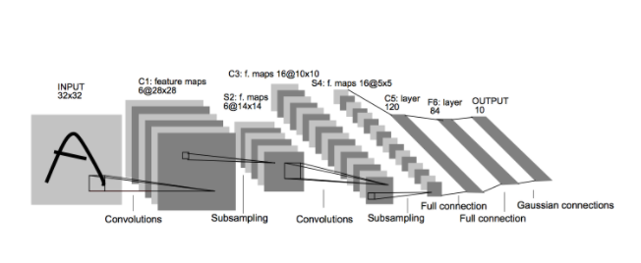
LeNet-5
It is the first model , simplest one.
Parameters: 60,000.
It was used to identify handwritten digits for zip code recognition in the postal service.
https://www.jeremyjordan.me/convnet-architectures/

Slide 18
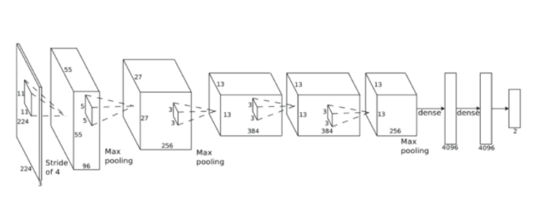
AlexNet
It is quite similar to LeNet-5, although this model is considerably larger .
It was developed to compete in ImageNet competition.
Parameters: 60 million.
https://www.jeremyjordan.me/convnet-architectures/

Slide 19
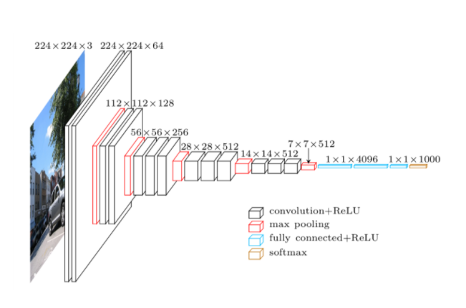
VGG-16
It is very deep model,it is deeper than above models.
Parameters: 138 million.
https://www.jeremyjordan.me/convnet-architectures/

Slide 20
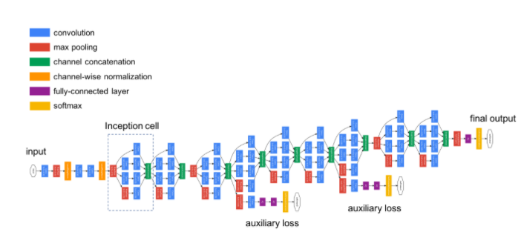
Inception
It is deeper version.
The main difference is the existence of two auxiliary outputs throughout the network, which benefited the end performance of the model and converging at a slightly better value than the same network architecture without an auxiliary branch. Parameters: 5 million (V1) and 23 million (V3).
https://www.jeremyjordan.me/convnet-architectures/

Slide 21
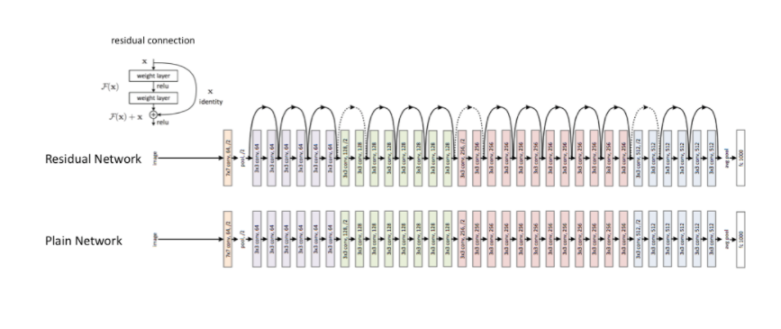
ResNet (Deep residual networks)
It enabled the development of much deeper networks (hundreds of layers as opposed to tens of layers).
Deeper networks are capable of learning more complex functions and representations of the input which should lead to better performance.
https://www.jeremyjordan.me/convnet-architectures/

Slide 22
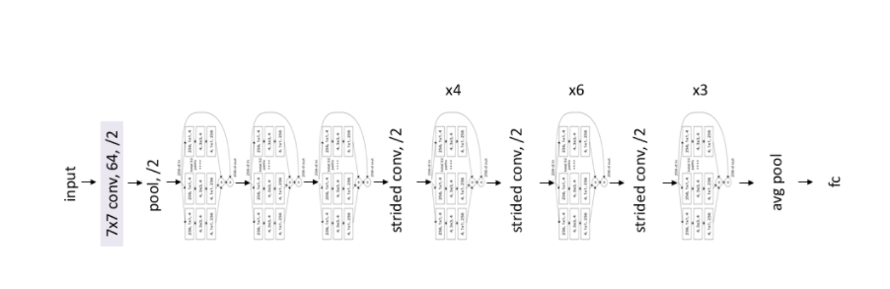
ResNeXt
ResNeXt architecture is an extension of the deep residual network.
It replaces the standard residual block with one that leverages a "split-transform-merge" strategy (ie. branched paths within a cell) which is more effective at benefiting model performance than increasing the width or depth of the network.
https://www.jeremyjordan.me/convnet-architectures/

Slide 23
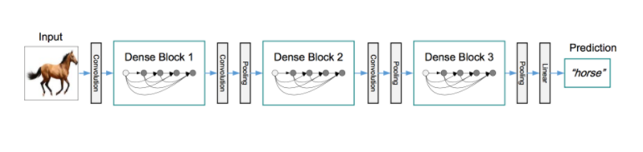
DenseNet
The idea behind dense convolutional networks: it may be useful to reference feature maps from earlier in the network.
Each layer's feature map is concatenated to the input of every successive layer within a dense block. This allows later layers within the network to directly leverage the features from earlier layers, which encouraging feature reuse within the network.
The authors state, "concatenating feature-maps learned by different layers increases variation in the input of subsequent layers and improves efficiency."
https://www.jeremyjordan.me/convnet-architectures/

Slide 24
End of Tutorial

Slide 25
Shaden

Slide 26
بدايه جزء شادن

Slide 27
Omar

Slide 28

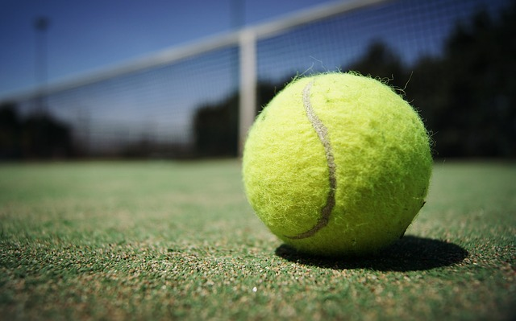
Tennis & Baseball Image Classification Using CNN and Deep Learning
GP – Training Phase

Slide 29
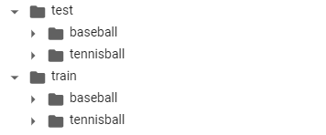
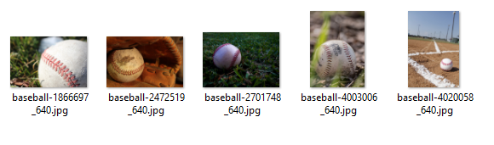
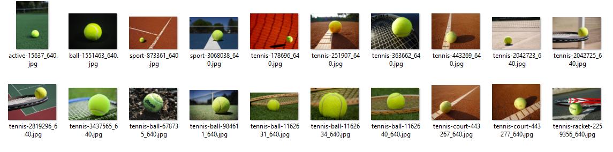
Dataset
25 images for each Tennis balls and Baseballs
20 images for training set
5 images for test set

Slide 30
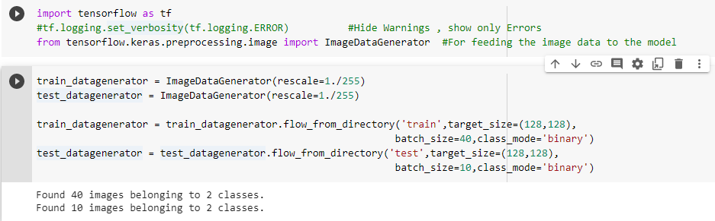
Reading the data
Here we prepare the data and read it from the directory
Determining the batch size and the class mode which is “Binary” in our case

Slide 31
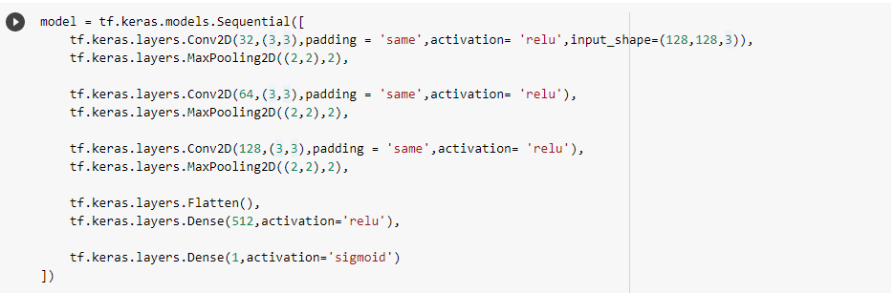
CNN Model Construction
Here we prepare the CNN layers to be applied on the input data
Defining the input to the Convolution, Max Pooling and Fully Connected layers
Using the activation function “ReLu” to receive the output from the convolution layer and swap all the negative values to Zeroes
Using the activation function “sigmoid” to classify the output into 2 classes

Slide 32
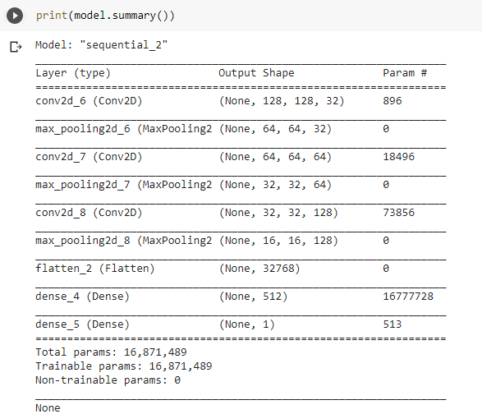
Model Summary
Make Sure that the model is ready with all the given parameters

Slide 33
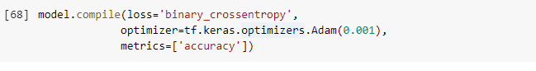
Model Compiling
Here we compile the model and define its loss function, optimizer, learning rate and metrics

Slide 34
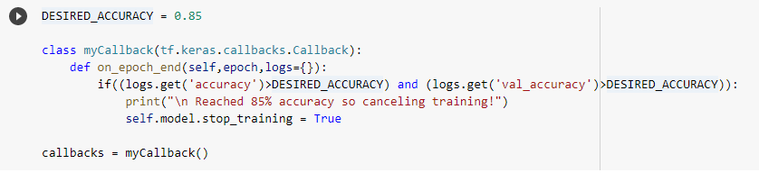
Model Training
Here we define a function that stops the model training after reaching a specific accuracy

Slide 35
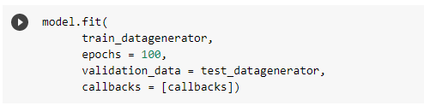
Model Training
Here we begin training the model over certain number of epochs using model.fit() which take the training data and the validation data sets as parameters

Slide 36
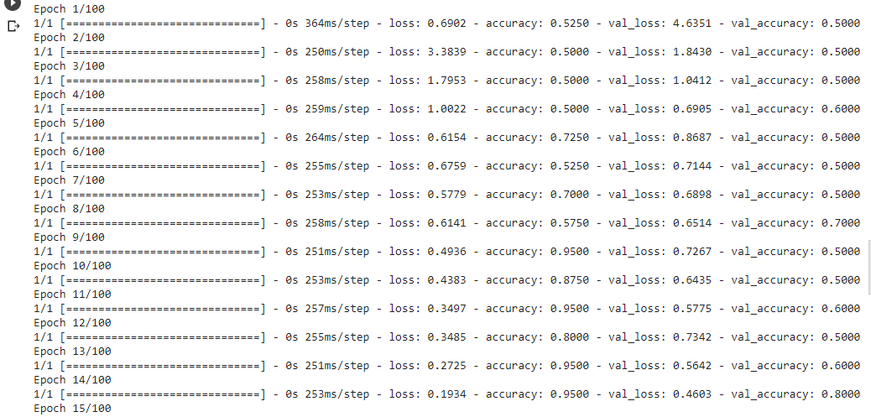
Model Training

Slide 37
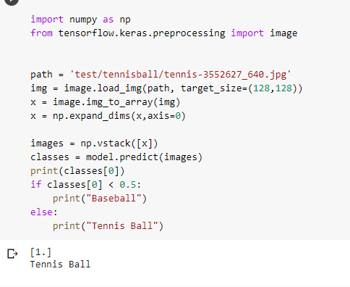
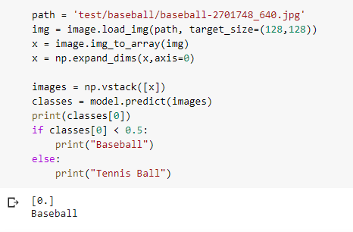
Model Validation
Here we test our model by giving it images from the test dataset
We can see that it classifies correctly the tennis ball and baseball images

Slide 38
Resources:
https://www.coursera.org/learn/building-deep-learning-models-with-tensorflow
https://www.youtube.com/watch?v=91o5XK_6PXU
https://www.tensorflow.org/tutorials/images/classification

Slide 39
Zeinab

Slide 40
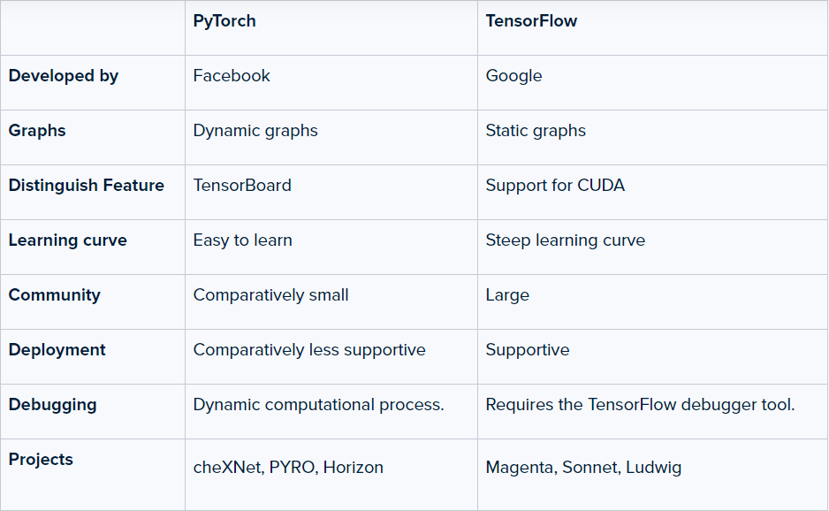
Tensor Flow or PyTorch ??
Both frameworks are useful and have a huge community behind them. Both provide machine learning libraries to achieve various tasks and get the job done. TensorFlow is a powerful and deep learning tool with active visualization and debugging capabilities. It also has support for mobile platforms and offers production-ready deployment. PyTorch, on the flip side, is still gaining momentum and attracting Python developers as it’s more Python friendly.
In summary, TensorFlow is used to make things faster and build AI-related products, while research-oriented developers prefer PyTorch.
https://hackr.io/blog/pytorch-vs-tensorflow

Slide 41
PyTorch Example to classify between old and young people.
1- Installation:
Install Anaconda: https://www.anaconda.com/products/individual
Install Pytorch: https://pytorch.org/get-started/locally/
Install CUDA: https://developer.nvidia.com/cuda-downloads?target_os=Windows&target_arch=x86_64&target
_version=10&target_type=exelocal (I think I can use GPU, but my system is AMD not Nvidia so I cannot use it)
2- Study PyTorch Tutorial: https://pytorch.org/tutorials/beginner/blitz/tensor_tutorial.html

Slide 42
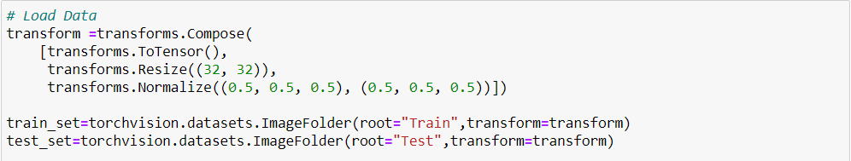
3- Data

Slide 43
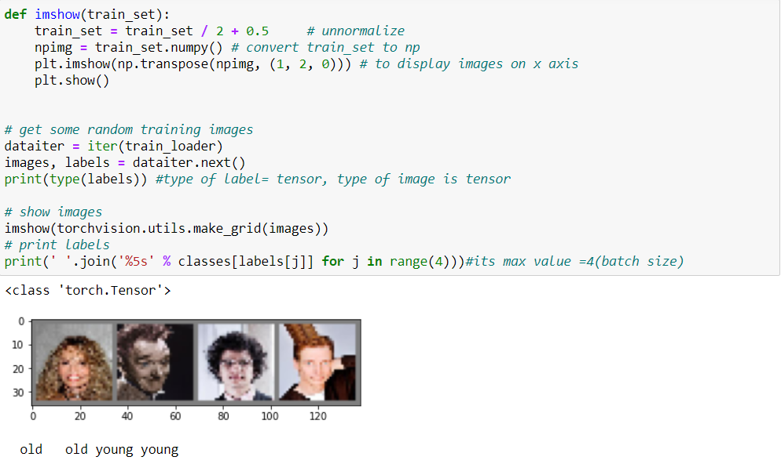

Slide 44
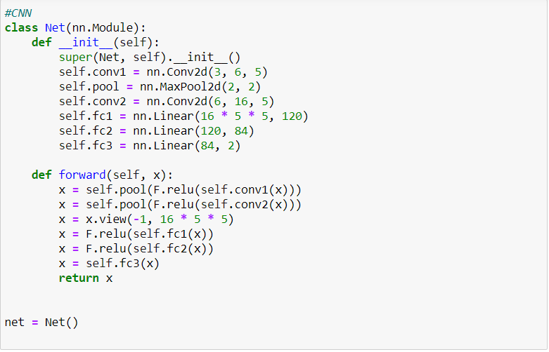
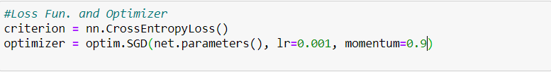
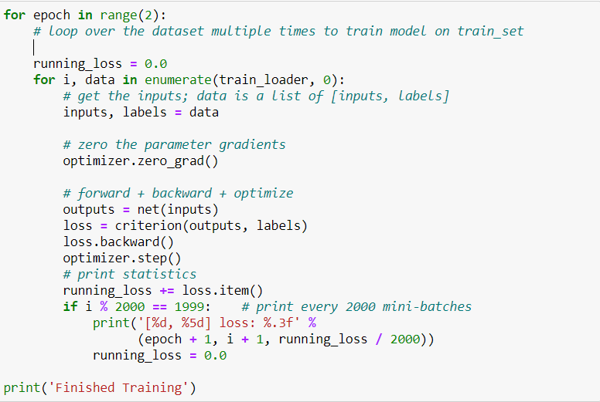
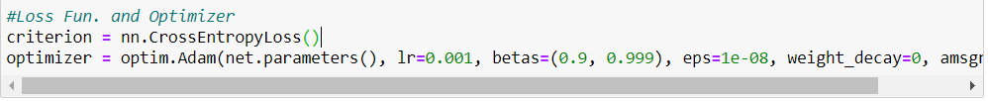
4- LeNet CNN architecture
https://pytorch.org/tutorials/beginner/blitz/cifar10_tutorial.html

Slide 45
5- Loss Functions:
Types of loss functions in PyTorch:
Mean Absolute Error Loss : used in regression problem.
Mean Squared Error Loss: used in regression problem.
Negative Log-Likelihood Loss: Multi-class classification problems.
Cross-Entropy Loss: Binary classification tasks.
Hinge Embedding Loss: used in classification problems, especially when determining if two inputs are dissimilar or similar.
Margin Ranking Loss: used in ranking problems.
Triplet Margin Loss: determining the relative similarity existing between samples, It is used in content-based retrieval problems.
Kullback-Leibler divergence: approximating complex functions and multi-class classification tasks.
Most fit loss function in this problem is Cross-Entropy Loss
https://neptune.ai/blog/pytorch-loss-functions

Slide 46
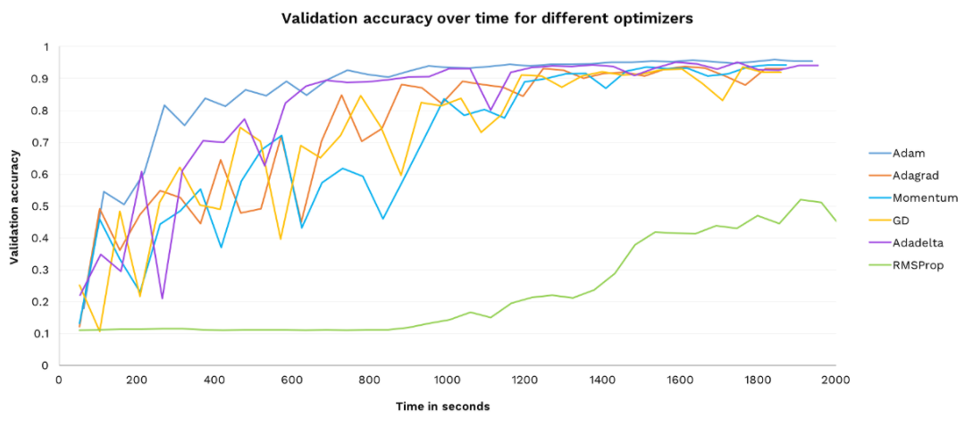
6- Optimizers:
Its role is to store and update the parameter state based on the calculated gradients of the loss function.
Performance of each optimizer varies according to model, dataset used.
https://medium.com/octavian-ai/which-optimizer-and-learning-rate-should-i-use-for-deep-learning-5acb418f9b2

Slide 47
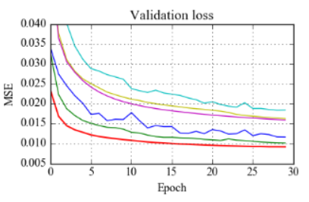
I tried SGD and Adam optimizers
SGD(Stochastic Gradient Descent) | Adam
Gradient descent is the rate of loss function w.r.t the weights and model parameters. | It is a technique implementing adaptive learning rate. (i.e. select a separate learning rate for each parameter).
The weights are updated after looping via each training sample. | Adam in some areas does not converge to an optimal solution.
https://medium.com/@Biboswan98/optim-adam-vs-optim-sgd-lets-dive-in-8dbf1890fbdc

Slide 48
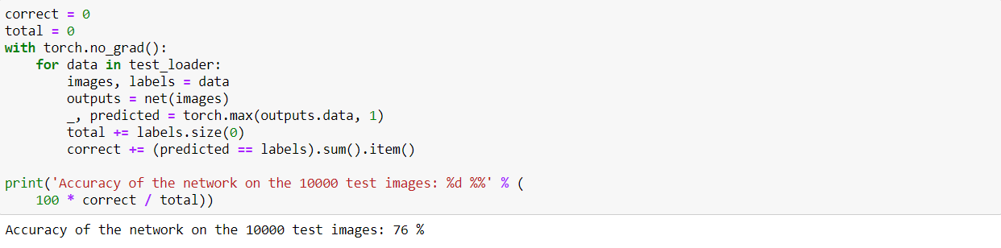
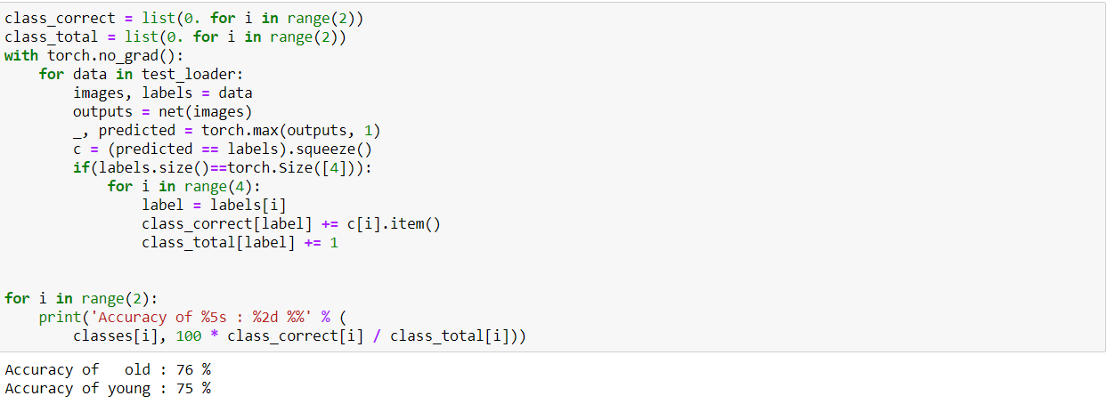
7-Final Results

Slide 49
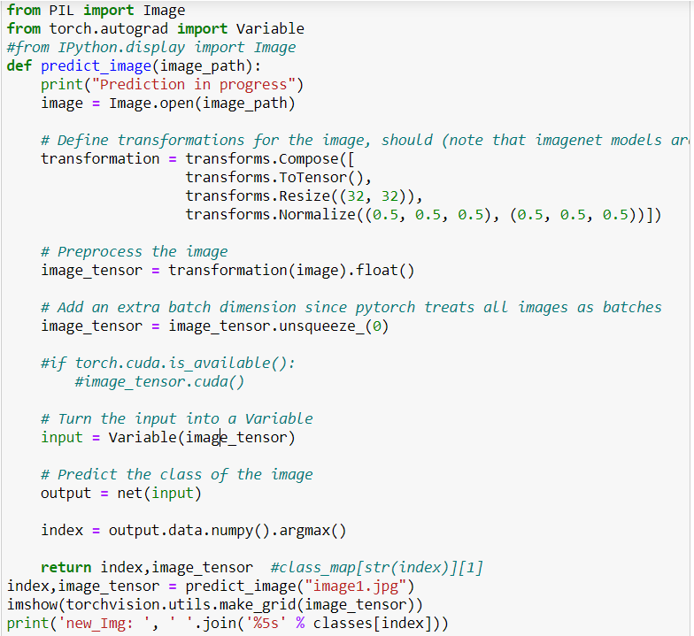
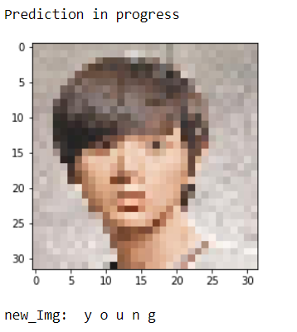
8-Test the model on new image
Output:
https://heartbeat.fritz.ai/basics-of-image-classification-with-pytorch-2f8973c51864

Slide 50
9-Try to improve the model:
Trial 1: for training set(Old & Young) of range 3000, test set (Old & Young) of range = 1000 , accuracy = 49%.
Trial 2: for training set (Old & Young) of range 6000, test set (Old & Young) of range = 2000 , accuracy = 49%.
Trial 3: for training set (Old & Young) of range 72000, test set (Old & Young) of range = 10000 , accuracy = 74%.

Slide 51
Change in model | Change in accuracy
1- Change SGD optimizer using nesterov momentum with Lr = 0.0001 | From 74% to 75%
2- Increase number of epochs from 2 to 5 with SGD optimizer, Lr=0.001 | From 74% to 76%
3- Change to Adam optimizer with 2 epochs, Lr = 0.0005 | 74% (No change in acc)
3- Use Adam optimizer with 2 epochs, Lr = 0.0001 or Lr = 0.001 or Lr=0.00146 | From 74% to 76%
4- Use to Adam optimizer with 3 epochs, Lr=0.00146 | From 76% to 74%
4- Use Adam optimizer with 5 epochs, Lr = 0.0001 or Lr = 0.001 or Lr=0.00146 | From 76% to 75%
5- Use Adam optimizer with 6 epochs or 10 epochs , Lr=0.00146 | 75% (No change in acc)
The best version is using Adam optimizer with Lr = 0.0001 or Lr = 0.001 or Lr=0.00146 on 2epochs

Slide 52
11-To do:
1- Split data into train ,validation and test sets.
2- Try different models and compare accuracies.
3- Use online GPUs to decrease computational time of deeper models and increase training set.

Slide 53
Mohammed Elsayed

Slide 54
Why Use PyTorch Instead Of Numpy …?!
1- Numpy is a great framework, but it cannot utilize GPUs to accelerate its numerical computations. For modern deep neural networks, GPUs often provide speedups of 50x or greater, so unfortunately numpy won’t be enough for modern deep learning
2- Here we introduce the most fundamental PyTorch concept: the Tensor. A PyTorch Tensor is conceptually identical to a numpy array: a Tensor is an n-dimensional array, and PyTorch provides many functions for operating on these Tensors. Behind the scenes, Tensors can keep track of a computational graph and gradients, but they’re also useful as a generic tool for scientific computing.
3- Also unlike numpy, PyTorch Tensors can utilize GPUs to accelerate their numeric computations. To run a PyTorch Tensor on GPU, you simply need to specify the correct device.

Slide 55
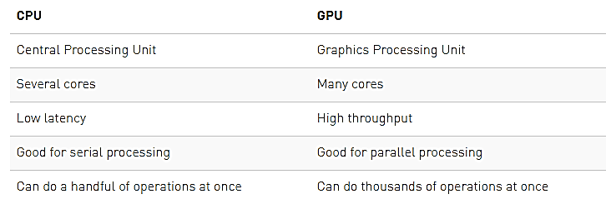
GPU Vs CPU
1- All Deep learning work need millions of multiplications and division processes witch are computationally expensive in processing, so we need a core that can make this process parallel for fast processing rater than do in series.

Slide 56
What is NVidia CUDA …?!
1- CUDA is a parallel computing platform and programming model that makes using a GPU for general purpose computing simple and elegant.
2- The CUDA platform is a software layer that gives direct access to the GPU's virtual and parallel computational elements.
3- This accessibility makes it easier for specialists in parallel programming to use GPU resources.

Slide 57
CUDA with PyTorch
1- To use the control of cuda over pytorch processing, we must install specific version of pytorch that satisfies cuda usage.
- Follow this link : https://pytorch.org/get-started/locally/
Problems With CUDA
1- It is only work on NVidia gpus, so its not supported in my pc : Radeon (TM) RX 550 .
Solutions
1- Online GPUS ( Free or paid ) :
i) Free like Paper Space : it gives gpu free but low performance (data upload problem)
ii) Paid: Wait for fund
2- Our Gpu without cuda: PyTorch ROCM

Slide 58
Male & Female Classification
i) Data Collection & Splitting
1- Search on Kaggle datasets
source: https://www.kaggle.com/cashutosh/gender-classification-dataset
2- Data Content : The data set is of cropped images of male and female . It is split into training and validation directory. Training contains ~23,000 images of each class and validation directory contains ~5,500 images of each class.
ii) Data Preprocessing
1- Resize: We need to resize the images to be (32*32) that will fit with our model.
2- Normalize: This help deep learning to learn faster and reduce the skewness, so we normalize all images to [-1,1].

Slide 59
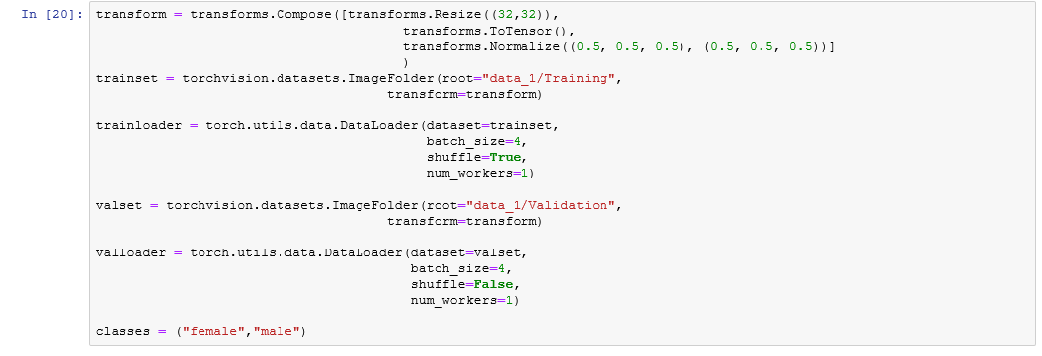
iii) Read Data & Convert it to pytorch tensors

Slide 60
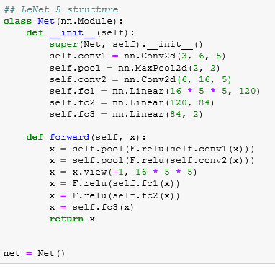
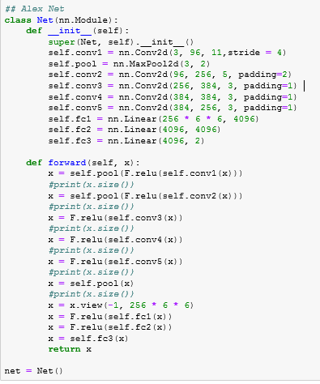
iv) Neural Network
LeNet 5
Alex Net

Slide 61
v) Loss Function & Optimization
SGD Optimizer
Adam Optimizer
- Both give same results

Slide 62
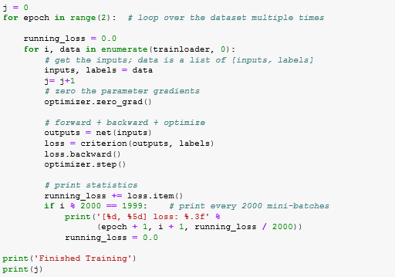
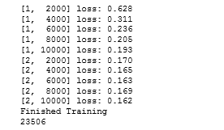
vi) Training The Model
LeNet 5
- Time : 4.5 min

Slide 63
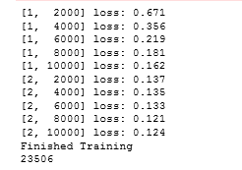
Alex Net
- Time :

Slide 64

vii) Get Accuracy On Test Data
LeNet 5
Alex Net
Acc = 94
Acc = 96
Reference link : https://pytorch.org/tutorials/beginner/blitz/autograd_tutorial.html

